Slide 1
Insurance Claims Frauds & Text Analytics
Adam Green
Enzo Martoglio

Slide 2
Presentation Overview
A short introduction to fraud in insurance
The development of new models of fraud analysis
Some challenges in modelling fraud
Examples of advanced analysis approaches
Text analytics with R
An example: Using the LIWC dictionary to detect fraud
The business case for R and enhanced analysis

Slide 3
A short introduction to fraud in insurance (1)
The scale of the problem is large, and potentially growing
Every week a staggering 2,670 fraudulent insurance claims worth £19 million are being uncovered as UK insurers intensify their crackdown on insurance cheats (ABI 9/2012)
Undetected US general insurance claims fraud total £2.1billion a year adding on average £50 to the annual costs individual policyholders face, on average, each year (www.insurancefraudbureau.org)
Fraud can impact many different areas of the value chain, from dishonest policy inception to staged events, to exaggerated claims, supplier claims padding etc.
UK Insurers detected 139,000 bogus or exaggerated insurance claims, up 5% on 2010. The value of savings on these frauds was nearly £1 billion - £983million - a rise of 7% on 2010.
Home insurance frauds were the most common with 71,000 dishonest claims, valued at £106 million, detected.
Dishonest motor insurance claims were the most expensive with savings of £541 million made from the 45,000 bogus claims uncovered. Fraudulent whiplash claims was the main factor for the rise.

Slide 4
A short introduction to fraud in insurance (2)
The nature of fraud covers a range of events and issues
The term fraud here refers to dishonest activities which could reduce an organisation’s profits (without necessarily leading to formal responses, e.g. legal)
Hard frauds
Clear and wilful act / planned / coordinated
Proscribed by law
Obtaining money or value
Under false pretences
Penal / police matter
Softer frauds / 'abuse'
Unwanted, unintended, unnecessary claims
Disputable damages
Civil matters
The incidence of 'hard' frauds is relatively small in many sectors
However, softer fraud and 'abuse' may be quite prevalent (between ¼ to 1/3 of all claims in motor and household?)
Important issues for insurances, honest policy holders and, increasingly, for regulators
Opportunity
Fraud Triangle
Motivation
Rationalisation

Slide 5
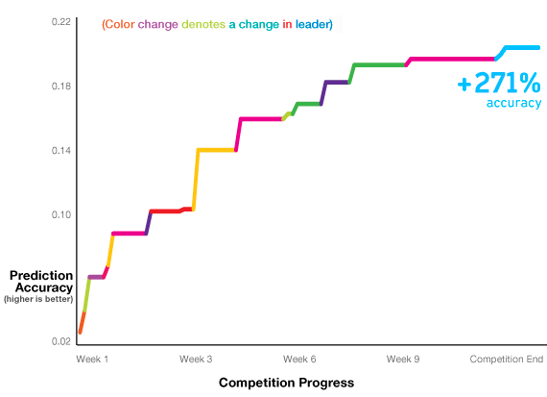
Development of New Models of Fraud Analysis
Rapidly growing sophistication and maturity
AllState launched a competition on the analysis site Kaggle in 2011
Competition: Predicting claims liability for injury from car accidents
Allstate provided anonymised training data and analysts submited multiple predictive models
The winning entry was 271% more accurate than AllState existing method for predicting claims based on vehicle characteristics
AllState is ranked as #4 in the Insurance (Property & Casualty) sector in US

Slide 6
Fraud Modelling Challenges
Data often not shaped for traditional approaches
Traditional regression analysis requires the availability of a dependent variable (e.g. Fraud Yes / No)
y = a + b1x1 + b2x2 + …+ bnxn
Fraud (Yes / No – or Fraud “Propensity Score”) → f(predictor variables)
Requires datasets where where claims have been properly determined to be fraudulent or legitimate (avoiding risks of under-reporting; analysis bias; censored data etc.)
Collecting and managing these data sets can prove complex and expensive
3rd Party or public data is rare, often not shared, not in the required form or in general not a good match for the type of analysis planned
Good data sets often take time to build and clean, and may be costly to keep up-to-date possibly missing newer fraud types

Slide 7
Examples of advanced analysis approaches (1)
Moving from traditional regression analysis
“Unsupervised learning” (machine learning)
No dependent variable required
Approaches available to work with category or continuous data
Use Information Augmentation to identify similar characteristics through different groups
Geocoding
Entity Extraction (text analytics)
Some useful methods:
Cluster Analysis
Records are grouped into categories with similar values (and differentiation)
An example – Kohonen’s Self Organising Maps (“SOMs”)
Unsupervised, nonparametric aggregation techniques
An example – PRIDIT (Principal Component Analysis of RIDITs)

Slide 8
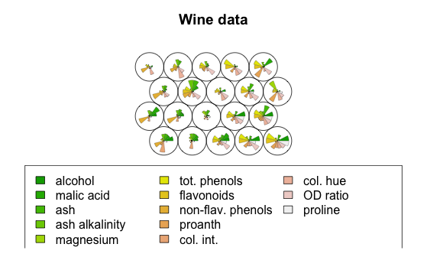
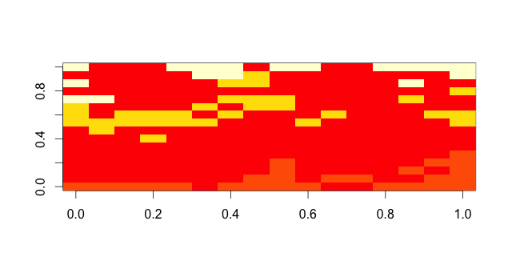
Examples of advanced analysis approaches (2)
Kohonen’s SOMs – a useful ML tool
Package: Kohonen
Package: RSNNS
(The R Stuttgart Neural Network Simulator)
Kohonen’s SOMs also available in Packages: SOM and WCCSOM

Slide 9
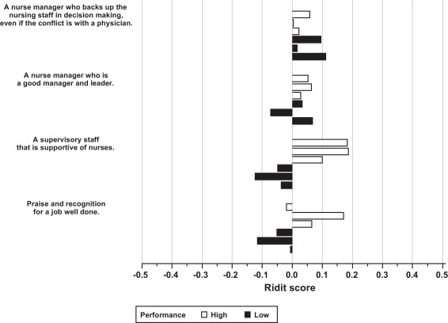
Examples of advanced analysis approaches (3)
RIDIT Scoring – A method for ordered qualitative measurements
Package: RIDIT
Analysis output is a score (not a cluster mapping)
the qualitative responses of each claim on every variable are transformed into numerical variable scores, without altering the ranked nature of the data
RIDIT analysis is used for data which are ordered (e.g. injury categories), but are not on an interval scale

Slide 10
PRIDIT as a fraud detection method
Brockett and colleagues (Journal of Risk and Insurance, 2002)
Use RIDIT scores – best for categorical data
PRIDIT—Principal Component Analysis (PCA) on RIDIT scores
Take binary, categorical, and continuous data (a unified PRIDIT method has been proposed to incorporate both categorical and continuous predictors)
Empirical cumulative distribution function on variables
Transform and normalize using RIDIT scoring
These variables proxy for an unobserved latent characteristic (i.e. fraud)
Use weightings and scores to determine likelihood of latent characteristic
Use PCA to assess variance and covariance of variables
Those that account for the most of the variation get the highest weighting

Slide 11
Examples of advanced analysis approaches (4)
Different approaches for different jobs
Kohonen SOM
Clustering has been shown to be effective in separating legitimate from fraudulent or abusive claims
Kohonen SOM helps to measure similarity / dissimilarity for unordered categorical variables with many values (i.e., injury type) variables
SOM is visually attractive but sometimes hard to interpret
It tend to create border problems
PRIDIT / (PCA + RIDIT)
Studies have indicated a strong relationship between PRIDIT scores and expert suspicion that claim is fraudulent or abusive
Score offer a clear to understand way to analyse a progression of claims
The relative importance of variables may be very different from supervised regressions
No out-of-the-box R Package for PRIDIT

Slide 12
Fraudulent Claim Scoring Workflow
Assigning a “suspicious level” score to each claim
More effort / resources on questionable claims
PRIDIT Score for all claims
Order Claims according to PRIDIT Score
Pay faster claims deemed to be authentic → Improve customer satisfaction

Slide 13
Using Text Analytics & R
to
Detect Fraudulent Claims

Slide 14
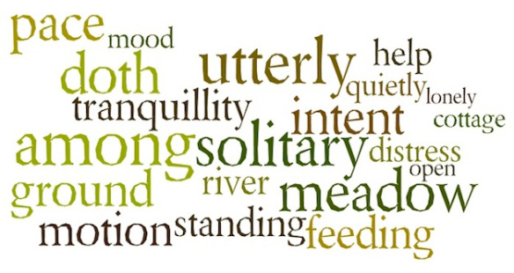
Text analysis using R (1)
Everyone is mining text... and discovering new knowledge
Words that are consistently more common in works by William Wordsworth than in other poets from 1780 to 1850.
Analysis by Ted Underwood, Associate Professor of English, University of Illinois
Graphic using Wordle’s display tool - R used to run a Mann-Whitney test (measures over-representation relative to a context)
Notes:
14

Slide 15






Text analysis using R (2)
A basic text analysis workflow
Information Retrieval
Document indexing
Storage
Natural Language Processing
Stemming
Stop-word filters
Disambiguation
Part of speech tagging
Etc.
Information Extraction
Term extraction
Concept extraction
Named entity extraction
Etc.
Data Mining
Classification
Clustering
Statistical analysis
Visual analysis
Retrieve & organise documents
Process & tag documents to ease information extraction
Create Structured data from Unstructured text
Outcome is gather new knowledge
Notes:
15

Slide 16
Claim Narrative Entity Extraction
Use a tokenizer for entity extraction
Wide choice in R: tm or Apache OpenNLP (preferred)
Compare with specific “claims’ family” bag-of-words (dictionaries)
Auto claims dictionary
Health claims dictionary
Property claims dictionary
Enrich the claims analysis / scoring
Examples:
Study on auto pre-accident conditions e.g. road works etc.
Extraction of any relevant medical terms used in the narrative
Identify potential excessive treatments in health claims
Potential subrogation opportunities
More fine-grained peril causes
Cause-of-loss: mine claimant / adjustor narratives

Slide 17
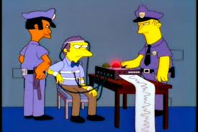
Deception – A Definition
Deception
Deliberate choice to mislead a target without notification
Often to gain some advantage
Excludes:
Self-deception
Theatre, etc.
Falsehoods due to ignorance/error
Pathological behaviours

Slide 18
Using the LIWC Dictionary to detect fraud (1)
Deceptive Narratives in Claims Linguistic Inquiry and Word Count (LIWC)
Professor James Pennebaker is psychology professor & psychology department chair at University of Texas - Austin
Developed a dictionary / SW tool known as Linguistic Inquiry and Word Count (LIWC).
LIWC works with natural speech or writing to predict whether someone is lying
Studies confirm that people trying to deceive others often give out valuable clues
Fewer I-words: Liars avoid statements of ownership, distance themselves from their stories and avoid taking responsibility for their behaviour
More negative emotion: words, such as “hate”, “worthless” and “sad” are. Liars are generally more anxious and sometimes feel guilty.
Fewer exclusionary words (i.e. less complex speech ): Including “except”, “but” or “nor”--words that indicate that writers distinguish what they did from what they did not do. Liars seem to have a problem with this complexity, and it shows in how they express themselves.
Notes:
Facial expressions aren't the only clue. Because deception is a social act involving language, researchers are also studying liars' verbal and written output to find distinctive patterns.
DePaulo and Morris say that liars take longer to start answering questions than truth-tellers--but when they have time to plan, liars actually start their answers more quickly than truth-tellers. And they talk less. On the whole, to other people, liars seem more negative--more nervous and complaining, and less cooperative--than truth-tellers, they say.
The content of conversations can be another tip-off. DePaulo and Morris report that liars seem to withhold information, either from guilt or to make it easier to get their stories straight.
"Liars' answers sound more discrepant and ambivalent, the structure of their stories is less logical, and their stories sound less plausible," they say. Liars also use fewer hand movements to illustrate their actions but are more likely to repeat words and phrases, they add.
18

Slide 19
Using the LIWC Dictionary to detect fraud (2)
Why use LIWC?
Exploit the claim’s narrative as part of the claim analytics
Add another “dimension” to the claims scoring
Extend the analysis to witness statements and any other written / verbal exchange with the claimants (if recorded and digitised)
Associated to claimant’s attributes (e.g. age; education etc.) promise to offer higher % of success
Note – commercial use of LIWC requires licence
LIWC has been used in different contexts (and different languages), consistently identifying liars in ~70% of cases

Slide 20
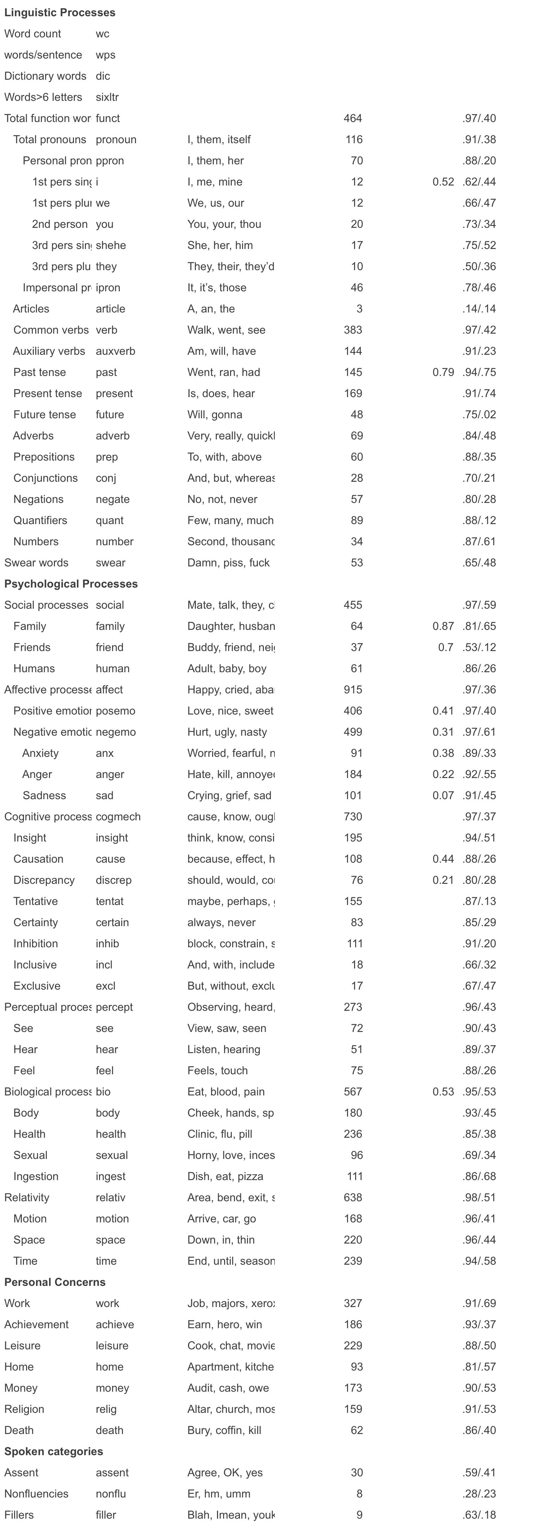
Using the LIWC Dictionary to detect fraud (3)
An extract from LIWC
LIWC attributes words to multiple Categories to define its search terms
LIWC enables users to grade & compare texts on the frequency of use of certain categories (notorious the comparison of US President candidate debate published by Prof. Pennebaker)
80 sub-dictionaries (categories)
Each sub-dictionary is comprised of words chosen and assessed by a set of judges who then agreed upon a set of sub-dictionary scales (93%-100% of the time).
Multiple international studies have proved the correlation between the presence / absence of certain categories’ words with deceptive speech
Notes:
20

Slide 21
LIWC Workflow
Store Claim text in a corpus
Tokenize Claim narrative
Calculate LIWC scoring
As LIWC proposes many categories it is necessary to identify the ones most relevant to the class of claims / types of narrative examined
This is done using a propositional rule learner:
Repeated Incremental Pruning to Produce Error Reduction (RIPPER) (proposed by William W. Cohen as an optimized version of IREP)
RIPPER is available in WEKA & accessible in R through RWEKA

Slide 22
The business case for R and enhanced analysis (1)
The business case for R and enhanced fraud analysis
A recent market survey of insurers* in the US found that there was a common recognition of the growing importance of anti fraud activities and technology, and:
88% are employing anti-fraud technology (with under half currently using it for non-claims areas, such as underwriting)
40% are using some form of text analysis for fraud detection
The top two anti fraud areas insurers are looking to invest in are predictive modelling and text mining
“We are an industry that could be accused of being data rich and knowledge poor” Murli Buluswar, Chief Science Officer at Chartis **
R is perfectly suited to developing advanced text analysis “proof of concepts” with limited resource, which shows whether the cost benefit can be met
* Source: SAS, The State of Insurance Fraud Technology, September 2012
Notes:
22

Slide 23
The business case for R and enhanced analysis (2)
Where does R fit and what are the alternatives?
Text mining is a growing and increasingly part of insurer’s anti-fraud analysis
R is very well suited to help you develop powerful text analytics
Text mining is simple to perform to a basic level, but requires careful thought, analysis and domain knowledge to achieve advanced results
R (OSS Version) is great for:
Rapid analysis and developing custom analysis approaches
Building prototype workflows (demonstrating repeatable automation)
Text analytics
R (OSS version) is not so good for:
Large scale text analytics (but hadoop could be easily integrated)
Live industrial grade process
Working with non-technical users
Other flavours of R may enable effective large scale text mining
Revolution R, Oracle R, IBM R; SAP R & TIBCO
Notes:
23

Slide 24
Summary Enhancement of the claims workflow
Refine and enhance models
Develop new data models, calibrations, corpus...
Claim
Collect claims data
Add any relevant textual narrative
Enrich
Customer attributes
GeoCodes
Collect narrative data
Social Media (text)
Social Media (graph)
Score
Score claim for fraud
Capture 'outcome data’
Investigate predictive models
Outcome
Review business impact

Slide 25
What Next?
Predictive Analytics of fraudulent claims is just one step in the journey
Scoring customers by:
“Risk profile” / Risk segmentation
Propensity to fraud
Address historically low post-claim retention rate
From
Scoring Fraudulent Claims
To
Scoring Customers to determine “ideal” customer profile

